Slide 1

Predict Aircraft Landing Time
Idea & Trend Sharing
© Amadeus IT Group and its affiliates and subsidiaries
Shuang LI
SGB-APT-R&D-AMS
22 Apr 2020

Slide 2
Agenda
Issues with ELDTs
Data quality of ELDT for our customer CX
Trend: more accurate ELDTs are needed
Existing component that can benefit from accurate ELDT

Slide 3
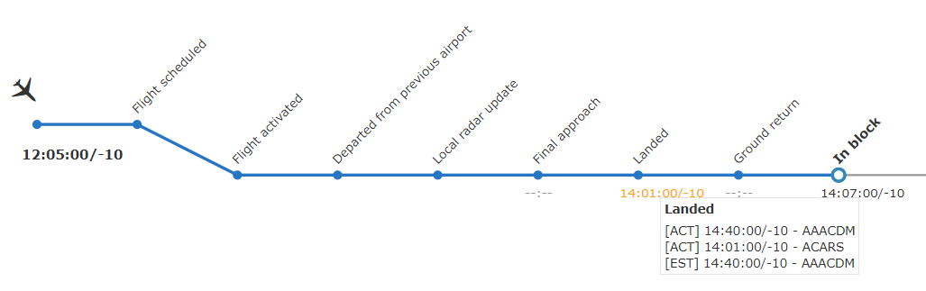
Predicting ELDT on final approach is trivial, but too late for resource reallocating if required
ELDT is important now as downstream decisions are taken
stand, gate, aircraft changes
prepare arrival sequence
turnaround operations
connecting pax decisions
TOBT updated, EIBT computed

Slide 4
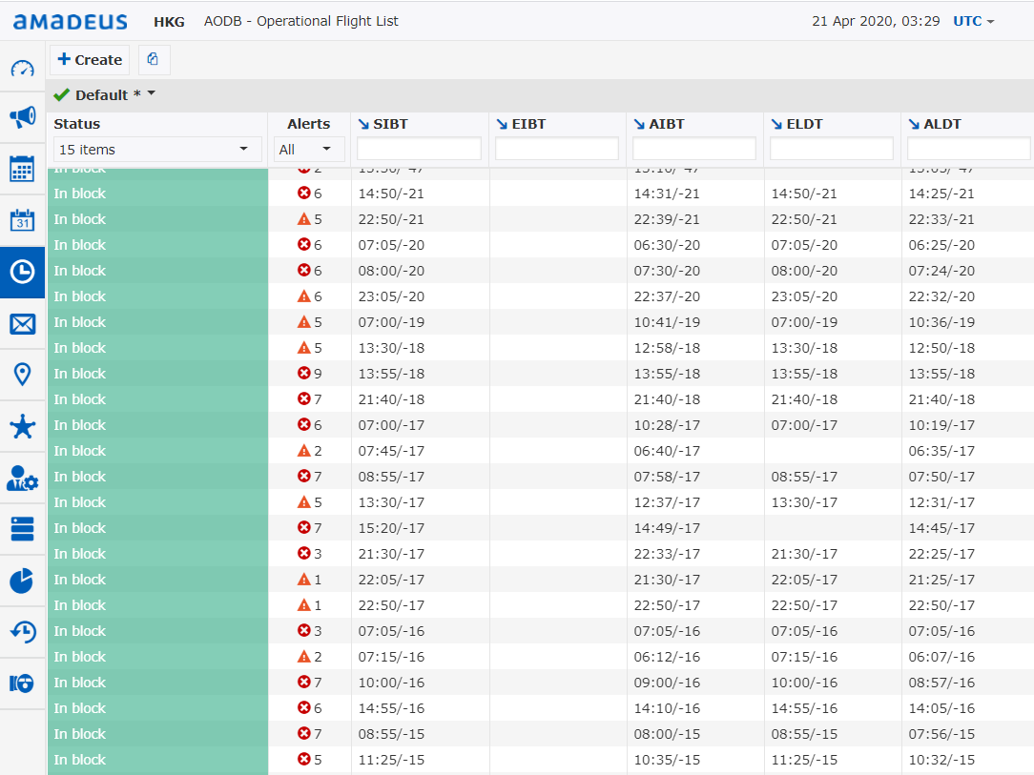
CX
Same as SIBT
Difference between ELDT & ALDT (in min)
25
17
40
36
33
216
40
0
0
ELDT is provided by Airport Authority Hong Kong
199
NA
65
59
NA
55
40
0
0
68
63
50
59
53

Slide 5





Trend: more accurate ELDTs are wanted
+
+
Oct 2017 – Oct 2018
prototype system for predicting ELDT and EXIT for long-haul flights (over four hours’ flight time) from the time the aircraft was airborne
POC efforts needed: a team spent 6 months
Accuracy: 95%
July 2019
FlightAware provides predicted ELDT based on statistical analysis of the trajectories and time stamps
In Europe, getting an accurate ELDT from ATC more than 45 minutes in advance becomes almost impossible
Feb 2020
Hire interns to work on:
Prediction of aircraft landing sequence,
Predictions of aircraft landing time,
Identification of probable trajectory.
Notes:
Spent 6 months to come up with the first implementation of a workable model
Because of the relative small size of ATC units in Europe
Boeing’s engineers have published related paper alr

Slide 6
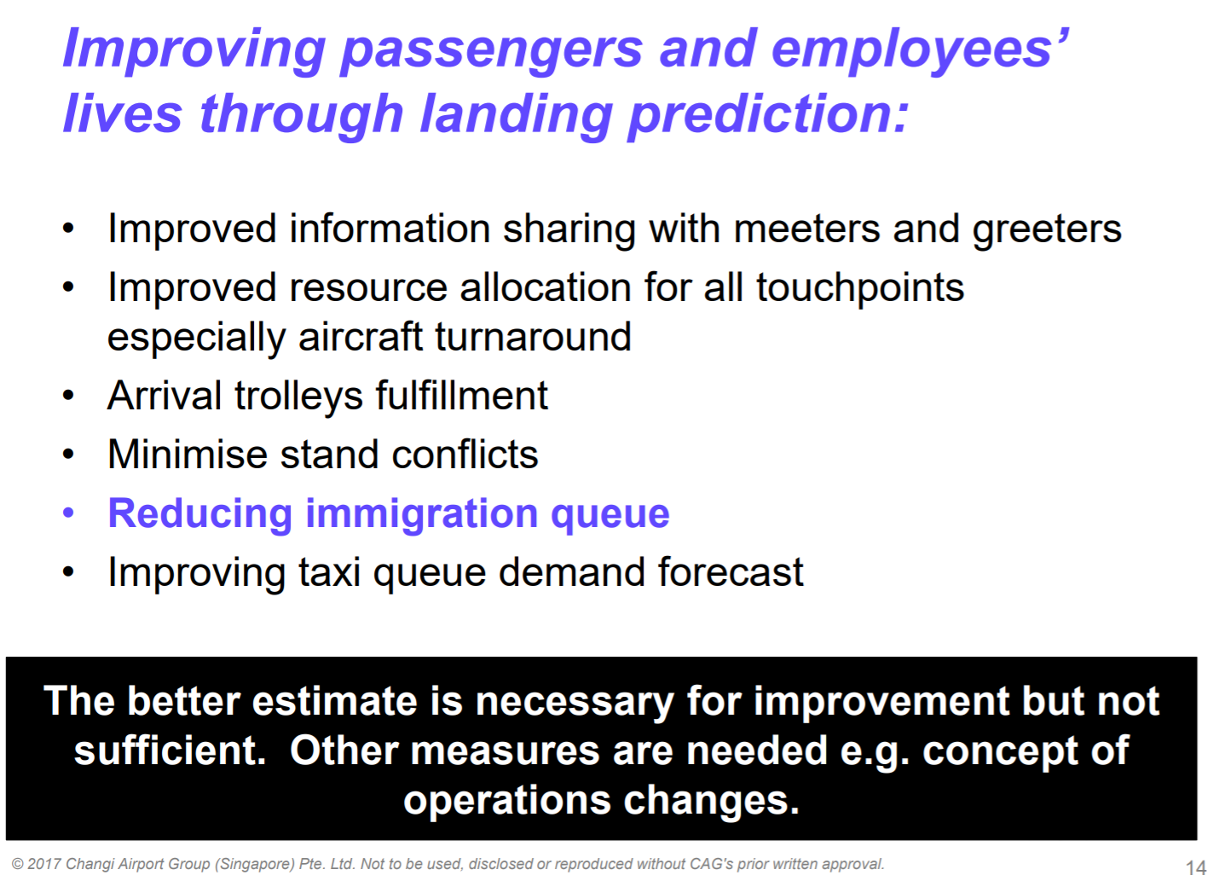
CAG

Slide 7
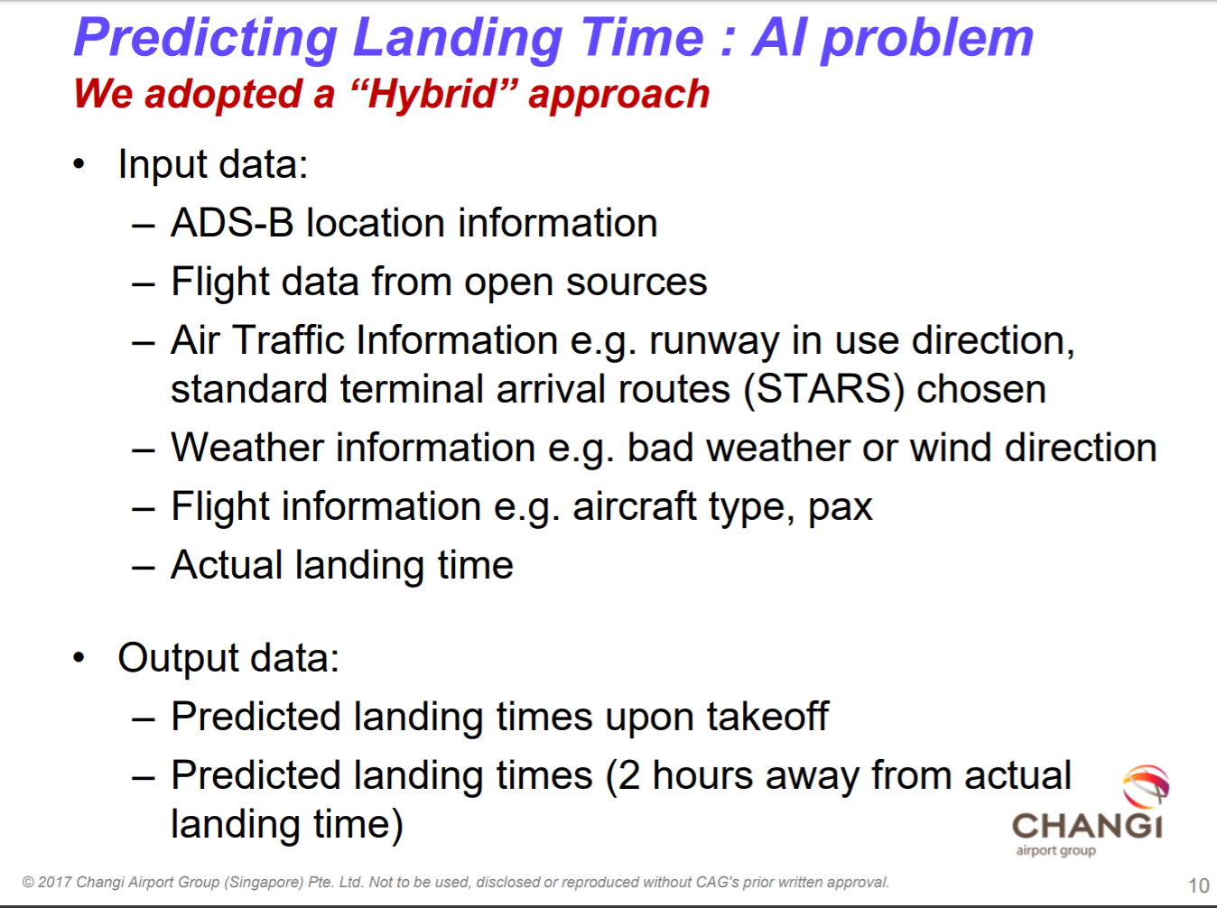
CAG: Input, Output
Free satellite data for research

Slide 8
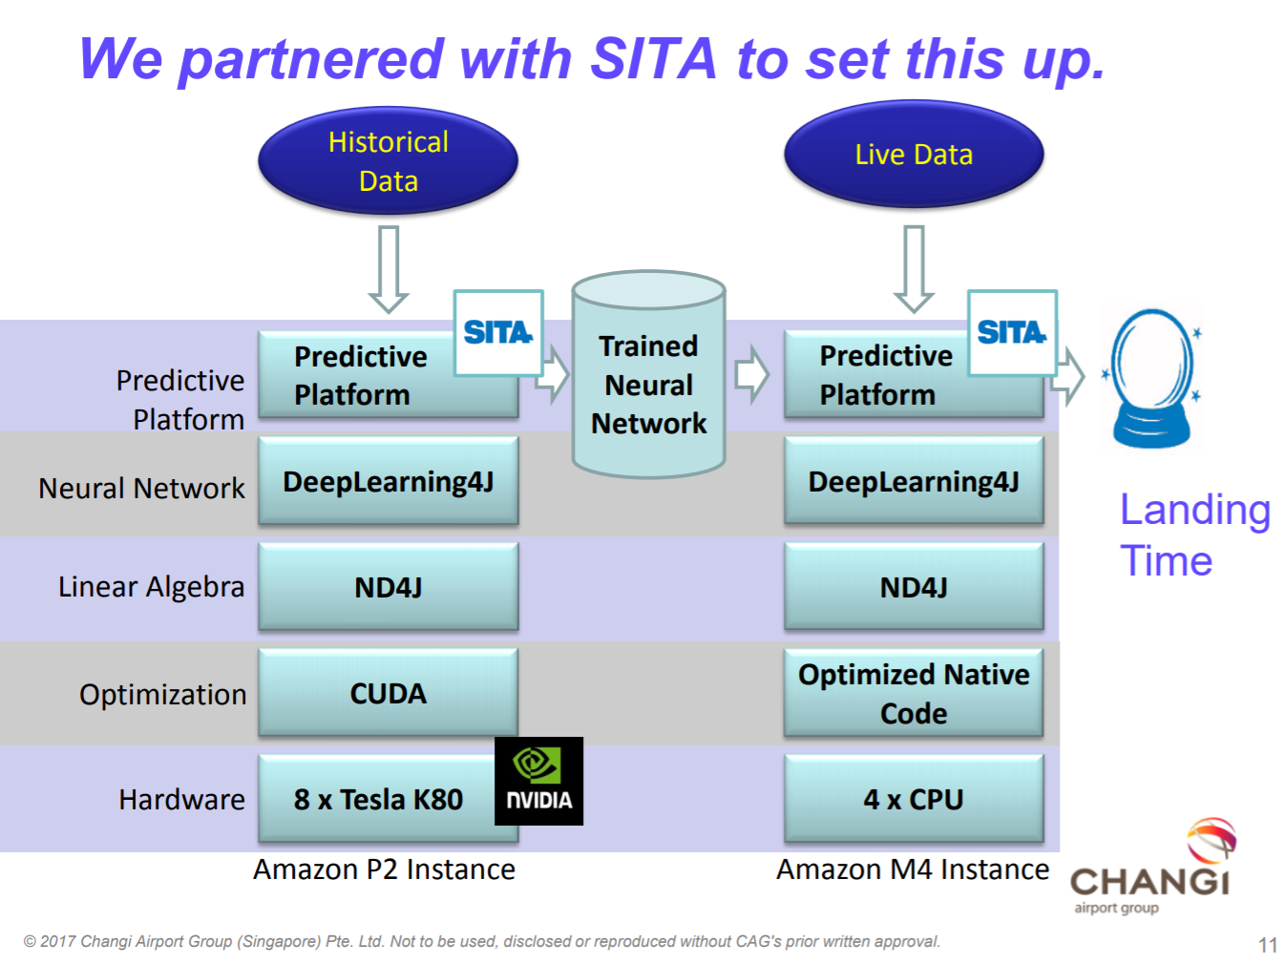
CAG
$0.8 per hour = $7k per year
$7.2 per hour

Slide 9
Products that can benefit from more accurate ELDT & EIBT
For arrival flights, Estimated taXi-In Time (EXIT) added to ELDT will provide an accurate EIBT
Beneficial for ground handling resource management at the gate, stand and gate planning and pre-departure sequencing
TAM: accuracy of TOBT depends on ELDT (and EXIT)
FRMS: gate congestion, changes and overlap can be reduced.
Depending on ELDT, other airport processes may be triggered for necessary recalculation, including stand and gate management
SEM: accurate EIBT is beneficial for sequencing departure flights
CXM: connecting decisions are taken when ELDT is updated

Slide 10
Thank you!
amadeus.com Amadeus.com/blog
You can follow us on:
AmadeusITgroup
Notes:
Backcover option 1

